Slide 1
Verb tenses
Consistency of Tense
&
Modals

Slide 2
Consistency of tense
Do not change needlessly from one tense to another.
To describe events that occur at the same time, use verbs in the same tense.
past tense
past tense
Sara peeked over the fence and saw a cornfield.
present tense
present tense
Sara peeks over the fence and sees a cornfield.

Slide 3
Consistency of tense
For events that occur at different times, use verbs of different tenses to show the sequence of events.
past tense
past perfect tense
The pitcher wished that he had practiced more before the game.
The action of wishing happened after the action of practicing was complete.

Slide 4
Consistency of tense
For events that occur at different times, use verbs of different tenses to show the sequence of events.
past tense
present tense
Yesterday, Nina told us that her brother works every week at the senior center.
The action of telling occurred at a specific time in the past. The action of working occurs now.

Slide 5
Consistency of tense
Proofread the paragraph for unnecessary changes of verb tense
Possible Answers
(1) I was in my room Saturday morning, planning to study for two hours. (2) To my surprise, Nancy Chang drops by. (3) She dashed into the house, runs up the stairs, and calls my name. (4) What she wanted was a fishing companion. (5) As I get my fishing gear together, I was so happy. (6) On our way to the lake, we notice some dark clouds. (7) We wished we checked the weather first.
(1) I was in my room Saturday morning, planning to study for two hours. (2) To my surprise, Nancy Chang drops by. (3) She dashed into the house, runs up the stairs, and calls my name. (4) What she wanted was a fishing companion. (5) As I get my fishing gear together, I was so happy. (6) On our way to the lake, we notice some dark clouds. (7) We wished we checked the weather first.
dropped
ran
called
got
noticed
had

Slide 6
Modals
A modal is a helping verb that is joined with a main verb or an infinitive to express an attitude toward the action or state of being of the main verb.
Helping verbs used as modals
can | could | may | might | must
ought | shall | should | will | would

Slide 7
Modals
The modal can or could is used to express ability.
Tammy can play point guard in the second half.
The team could have made better shots.

Slide 8
Modals
The modal may is used to express permission or possibility.
Permission
Yes, you may borrow my sweater.
Possibility
My clothes closet may be too full.
The modal might is used to express possibility.
I might give some of my clothing to charity.

Slide 9
Modals
The modal must is used most often to express a requirement.
Sometimes, must is used to express an explanation.
Requirement
We must conserve energy in our homes.
Explanation
My brother must have left the lights on.

Slide 10
Modals
The modal ought is used to express an obligation or a likelihood.
Obligation
Reggie ought to study harder for math quizzes.
Likelihood
The next quiz ought to be more difficult than the last one.

Slide 11
Modals
The modal will or shall is used to express future time.
I shall enter my painting in the contest.
After reviewing the entries, the panel will announce the winner.

Slide 12
Modals
The modal should is used to express a recommendation, an obligation, or a possibility.
Terrell should leave soon to catch the bus.
Recommendation
Obligation
All students should get to school on time.
Should you arrive late, please go to the office first.
Possibility

Slide 13
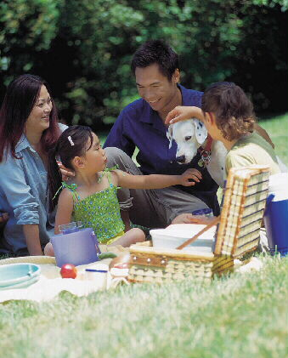
Modals
The modal would is used to express the conditional form of a verb.
In other words, it is used to express a situation that is contrary to fact.
If the weather had been more pleasant, they would have gone on a picnic.
Mrs. Chang would be happy to prepare food if you bring the plates and forks.

Slide 14
Modals
Would can also be used to express future time in a subordinate clause when the main verb in the independent clause is in the past tense.
past tense
modal expresses future time
They promised us that they would bring the music.
They promised us that they would bring the music.
Main clause
Subordinate clause

Slide 15
Modals
Would is sometimes used to express
an action that was repeated in the past
Every day she would wake early and feed the hens.
an invitation or offer
Would you like a nice, fresh salad?
a polite request
Would you please bring me those books?

